Slide 1


Poster should contain the following:
Title of the project
Aim
Vision
Mission
Requirements/Apparatus - Investment
Budget Expected and allocation
SWOT analysis
Action plan(GANTT chart)
Pictures/Details of materials to be used
Model design
Pictures of expected model
Applications

Slide 2
Title of the project
H&S Department, MLRIT
Aim:
Vision:
Mission:
Project requirements:
SAMPLE
Poster Format
Design
SWOT
Action plan(GANTT)
Budget Allocation
(Expected)
Applications
Presented by:
Reference :

Slide 3
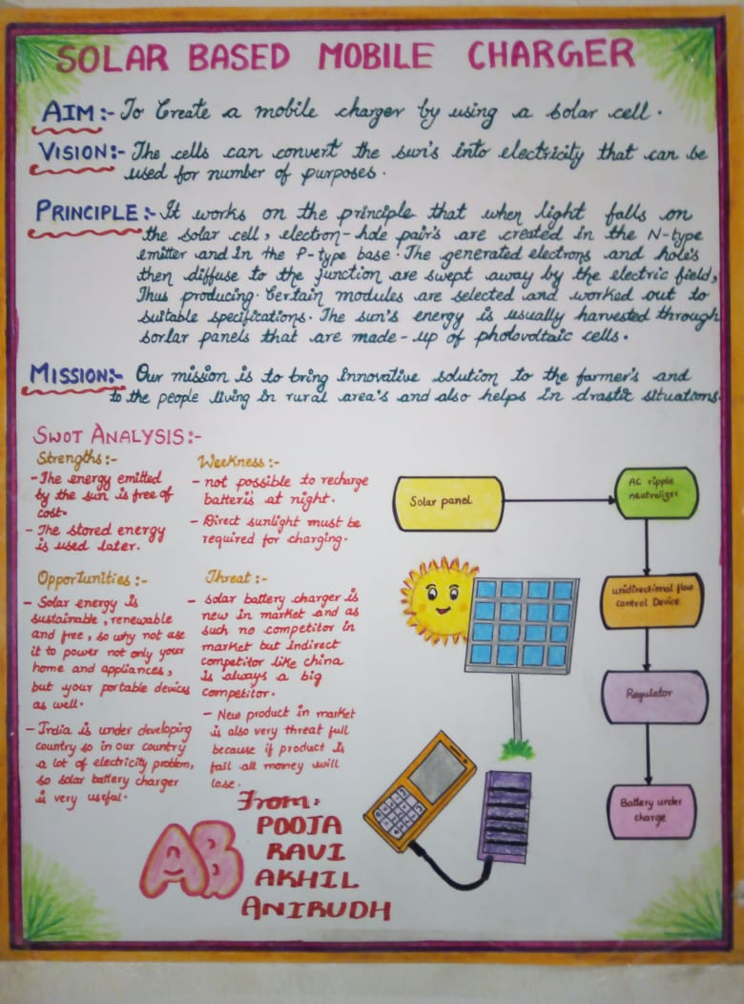
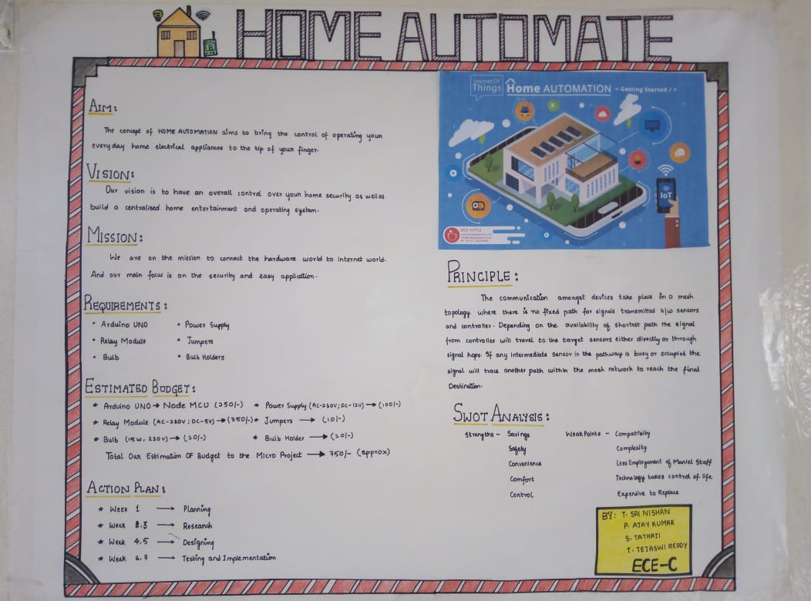
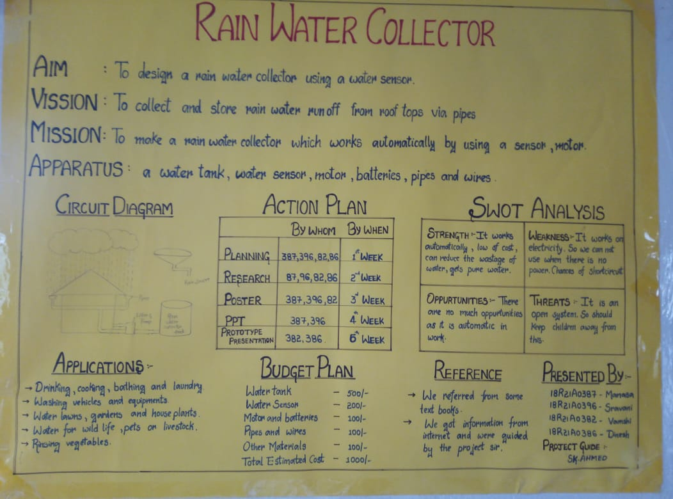

Slide 4


Project Design
Block diagram
A diagram of a framework in which the principal parts or functions are represented by blocks connected by lines
[or]
Circuit diagram
Simple circuit connection of all the devices, indication with terminal names and sings.
Project
Design
[or]
Expected prototype drawing or image
Drawings which are visually communicated how prototype functions or is constructed
[or]
Working prototype model
A preliminary, simple design is created for the project.

Slide 5
SWOT Analysis
STRENGTHS
WEAKNESS
Factors that can generally be controlled, that determine the success of a project.
Weaknesses are internal factors that can make it difficult for a project to succeed.
S
W
O
T
OPPORTUNITIES
THREATS
uncontrollable factors that could help the project succeed. These opportunities may be current but not yet exploited.
external factors that could harm the project if they occur. As with opportunities, they can be current or future threats.

